Slide 1

Test Summary Report STR
“THEBEATLES" Website
Katya haimov

Slide 2
Test Summary Report
Purpose ………………………………………………………….3
Application Overview……………………………………..4
Metrics…………………………………………………………..5-7
Recommendations………………………………………….8
Conclusion……………………………………………………..9
Bugs List………………………………………………..……….10
Bugs Report………………………………………………..….11-27

Slide 3
Purpose
This document presents findings related to the tests carried out on the
website of "The Beatles" in Israel.
The tests were performed on the functions of the site, reference
Actions such as: navigating and displaying the menu, accessing
articles, listening to podcasts.
Joining the mailing list, using various features, reading information, etc.

Slide 4
APPLICATION OVERVIEW
The website of "The Beatles" is mainly used as a web and mobile site.
To display and provide information about the Beatles.

Slide 5
Metrics
Test Cases - Status
Passed | Failed | Not Run | Total
36 | 15 | 9 | 60

Slide 6
Severity Bugs-Status

Slide 7
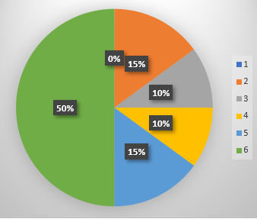
Defect Distribution - Module Wise
Total | Links | Photos | Videos | Site navigation
0 | 0 | 0 | 0 | 0 | s1-Show stopprer
8 | 3 | 1 | 4 | 0 | s2-Critical
2 | 2 | 0 | 0 | 0 | s3-Major
2 | 2 | 0 | 0 | 0 | s4-Minor
3 | 3 | 0 | 0 | 0 | s5-Low
15 | 10 | 1 | 4 | 0 | Total

Slide 8
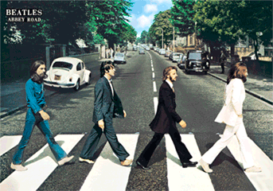

Recommendations
1. That the articles were numbered so
that you could skip between the pages
and not wait for the page to load, that
way it would also be possible to find the
desired article more quickly.
2. That the menus in the lower part that
show the division of the articles on the
site will be displayed on the site even if
you scroll down and will not disappear
from sight.
3. Improving the loading time of the
home page.
4. Inclusion of videos and photos in a
proper manner in all articles.

Slide 9
conclusion
Following the various tests done on the "The
Beatles" website, quite a few bugs were found.
Most of them have a degree of severity between
low and big.
Therefore, despite the relative amount of bugs,
the site still functions in a reasonable manner
and performs its main functions, which are
viewing in the articles.
As a result, I recommended releasing the site.

Slide 10
Bugs List
HTCI-15. Video not available
HTCI-14. Transition between pages
HTCI-13. Site navigation
HTCI-12. Accessibility check
HTCI-11. A blank page with no content
HTCI-10. Video is inactive
HTCI-09. Link windows are not responding
HTCI-08. Invalid links
HTCI-07. Video not available
HTCI-06. Video link not available
HTCI-05. Videos not available
HTCI-04. Pictures not attached
HTCI-03. RSS link links to page with error
HTCI-02. Clicking on a radio signal links to a
page with an error
HTCI-01. A search engine on the site displays
truncated results.

Slide 11
Bug List

Slide 12
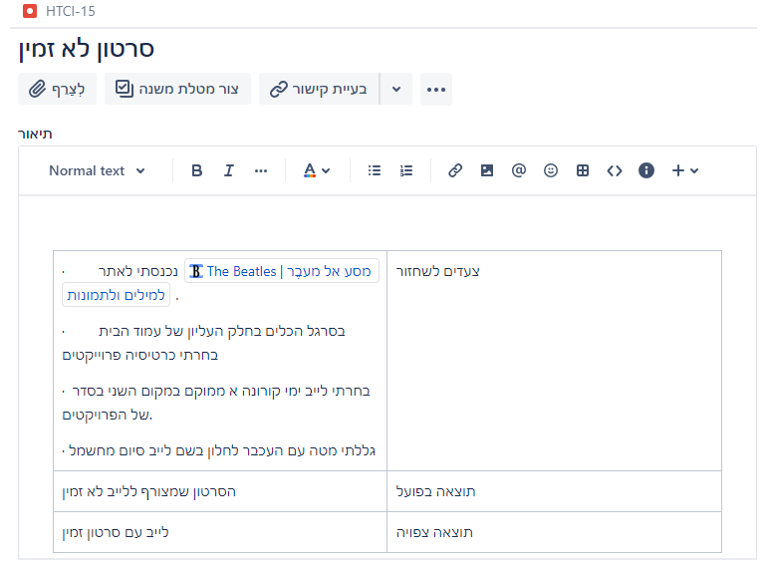
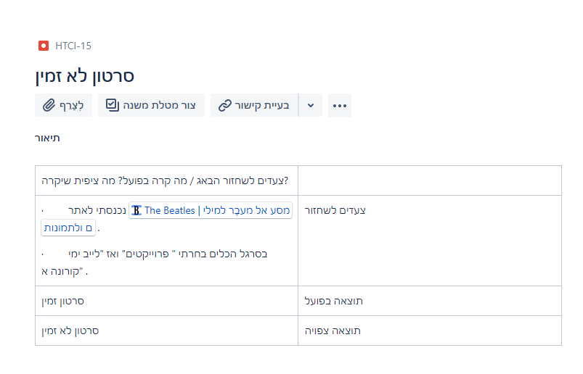
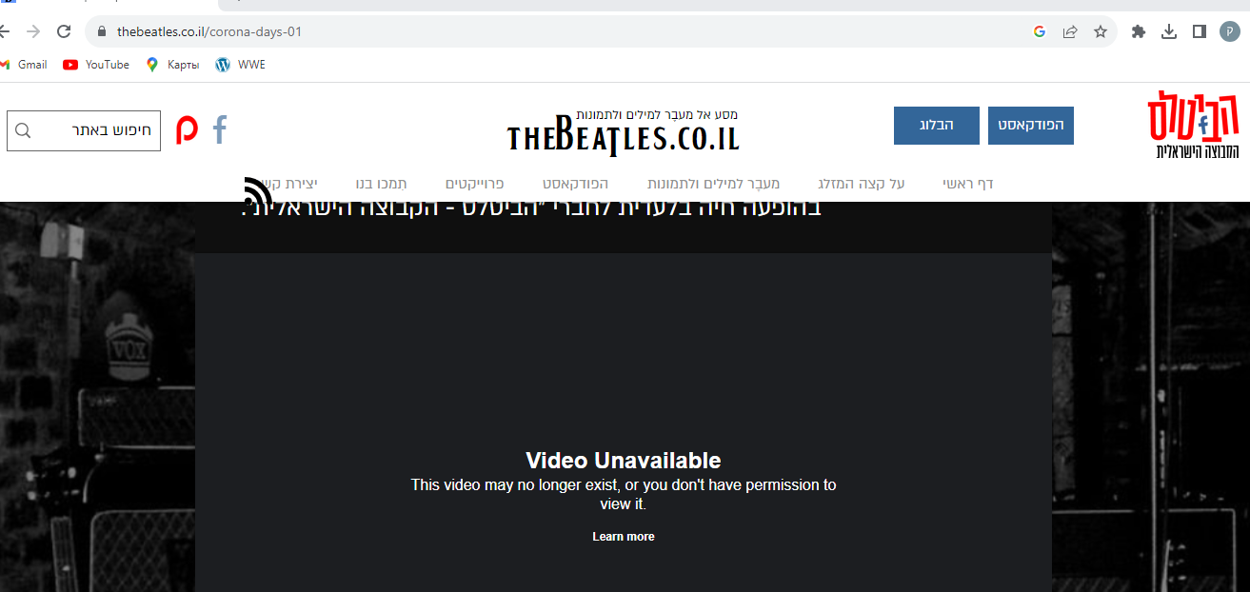

Slide 13
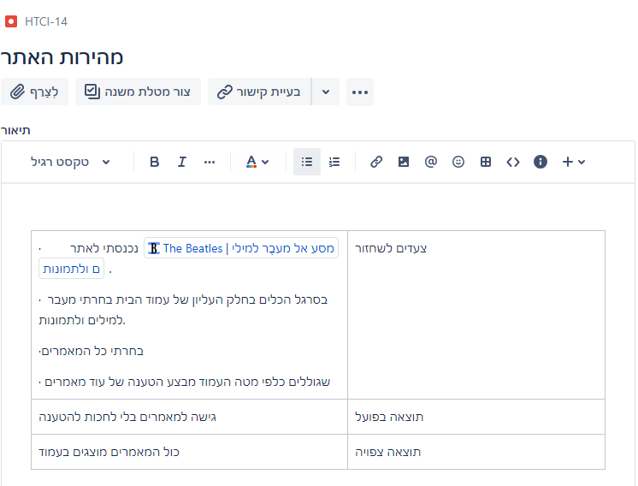
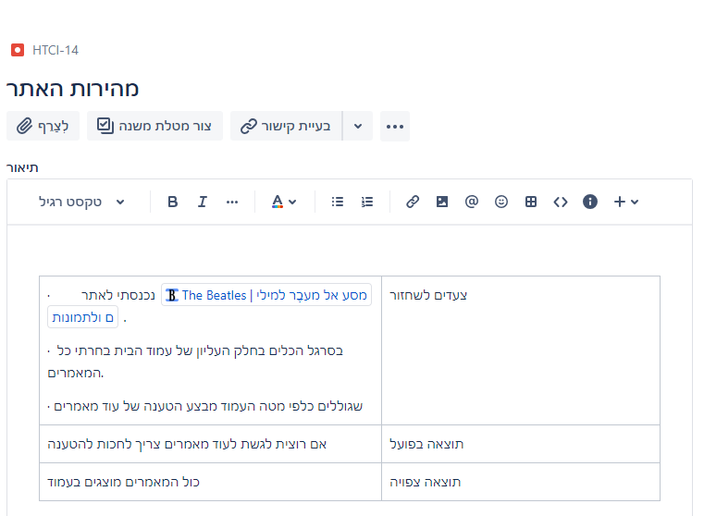
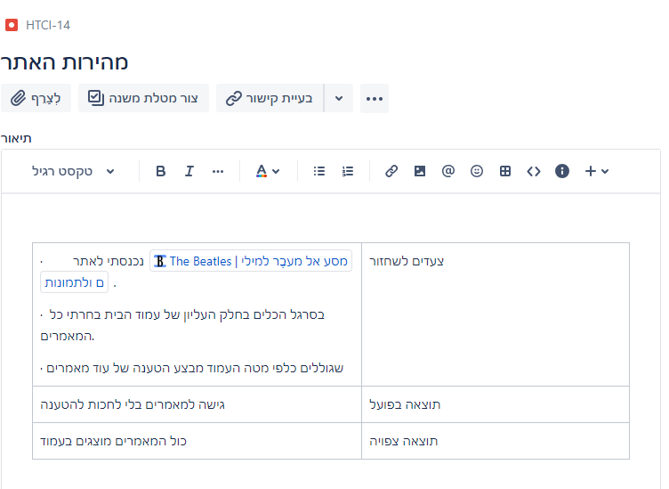
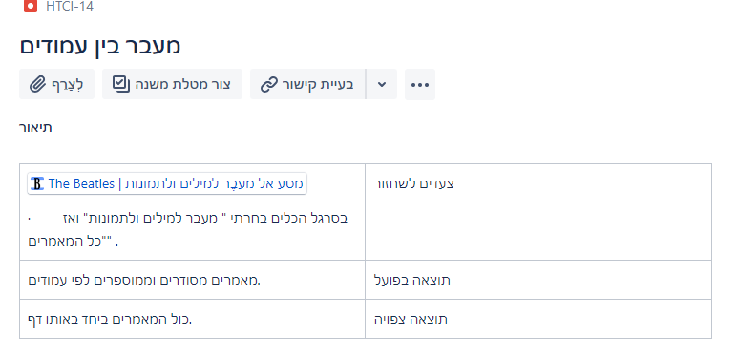
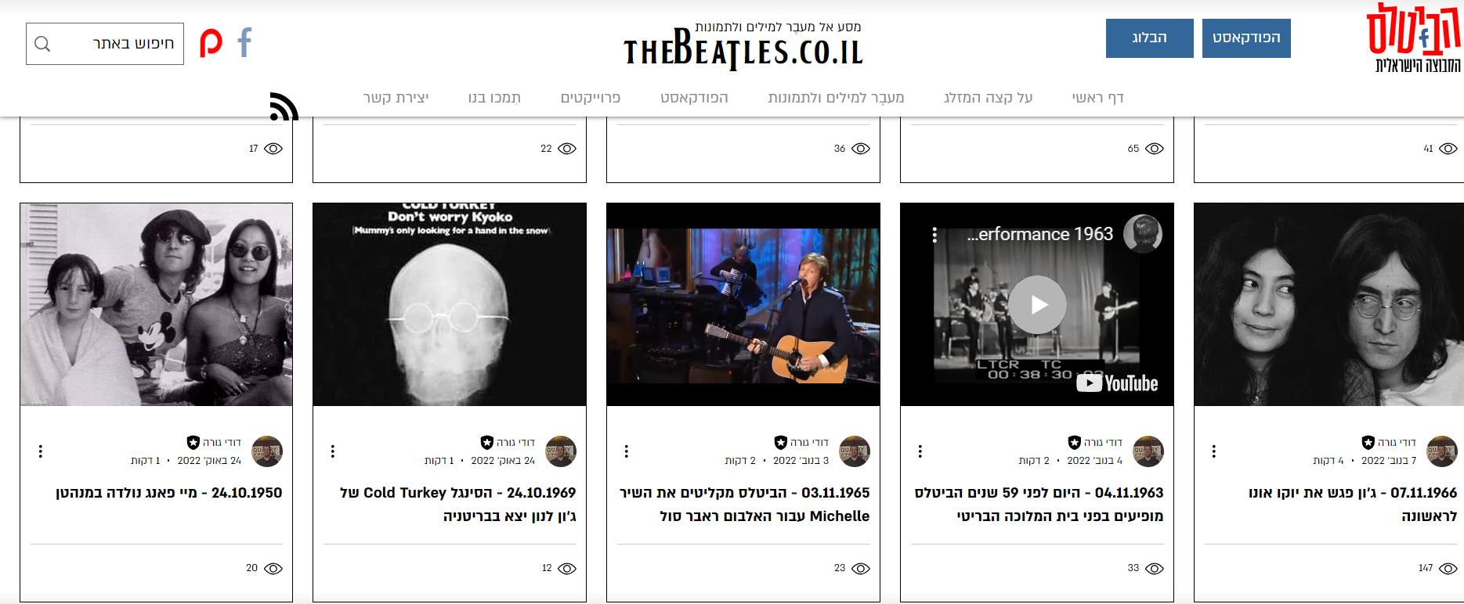

Slide 14
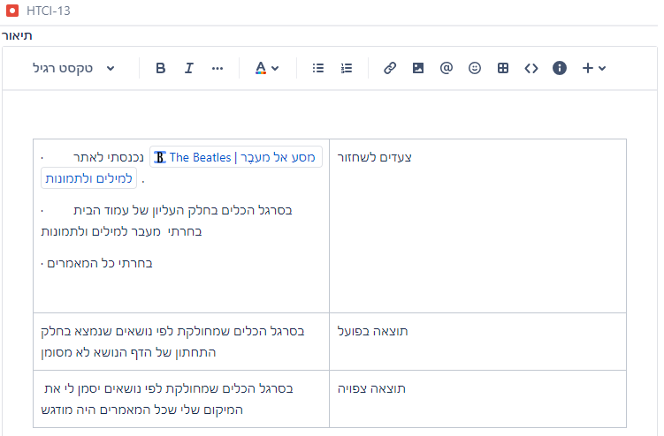
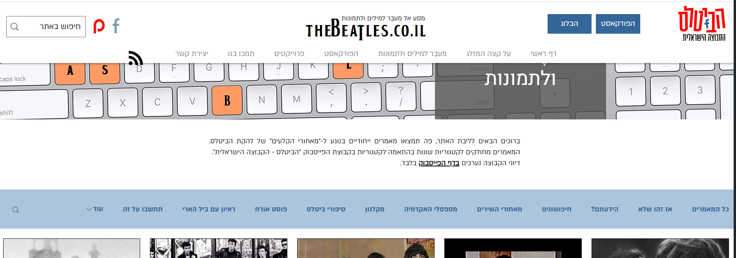

Slide 15
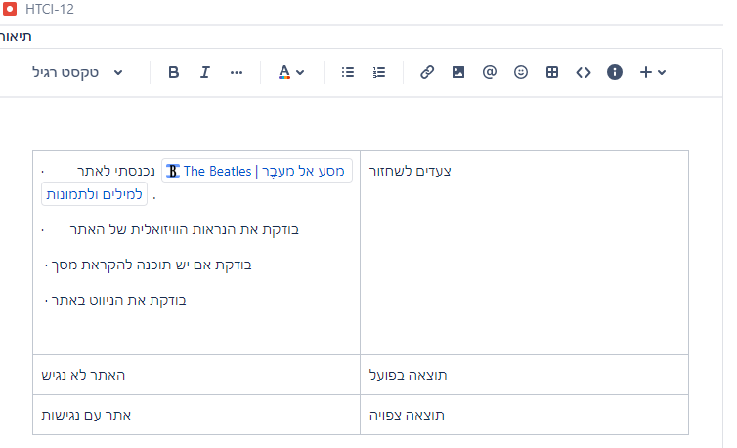
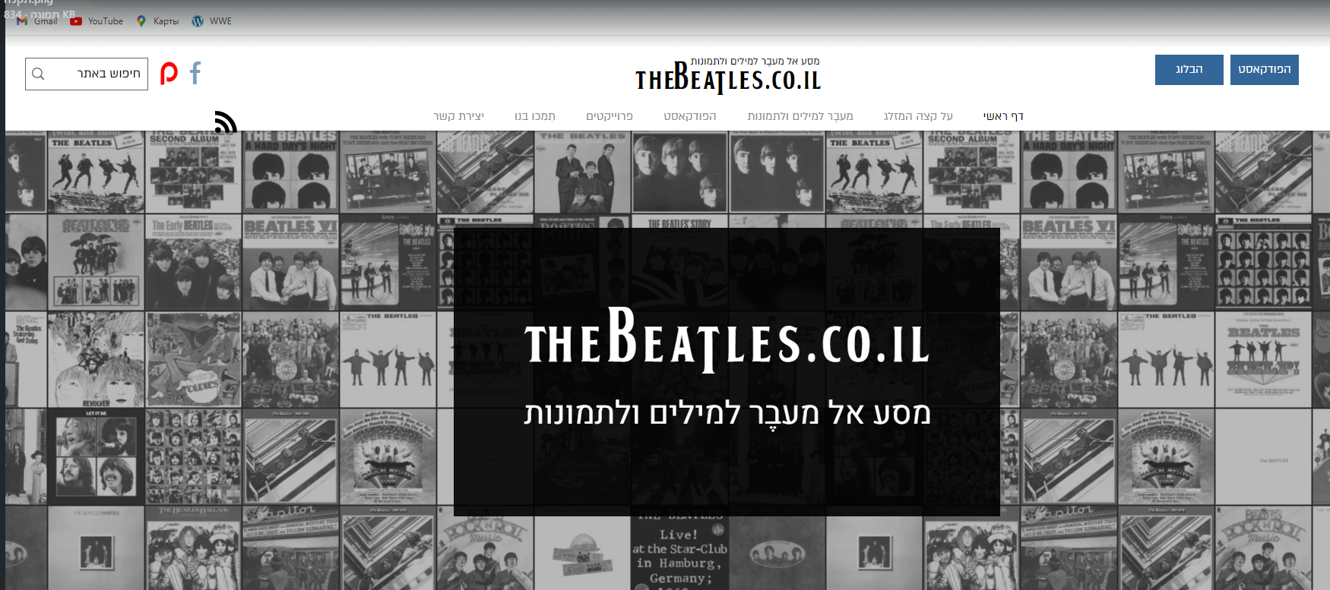

Slide 16
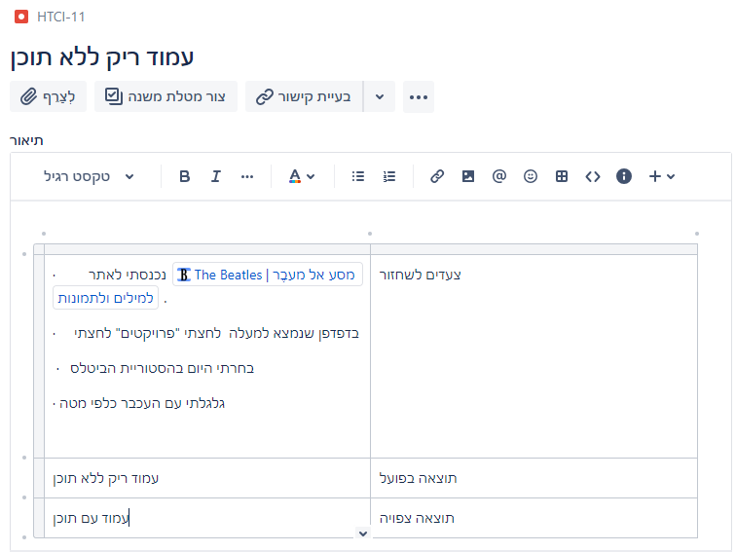
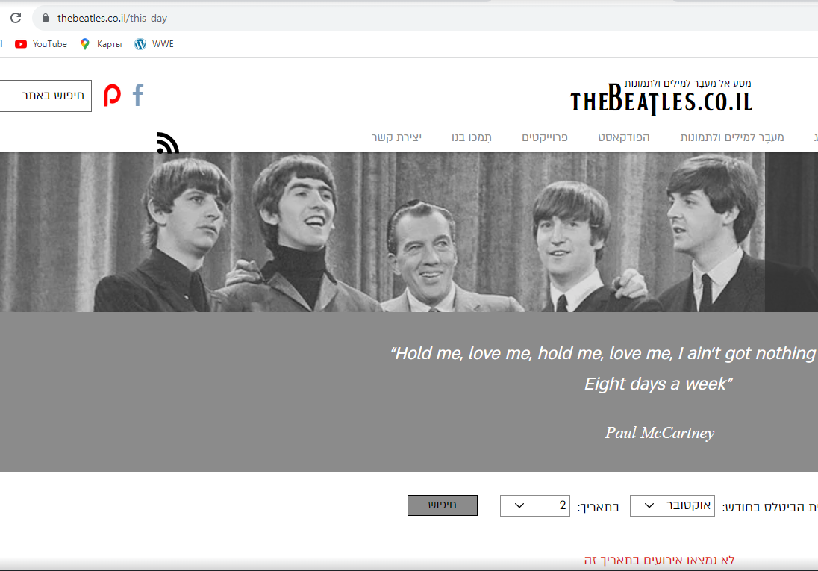

Slide 17
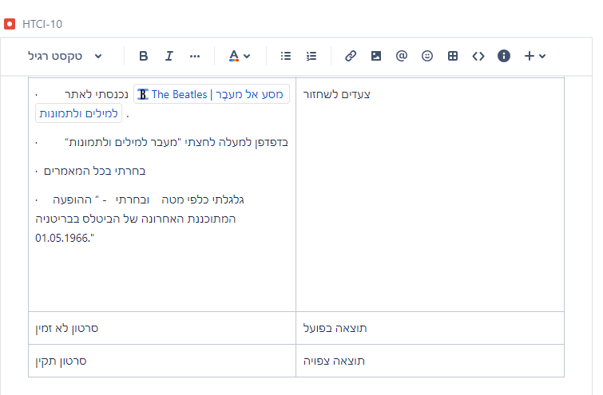
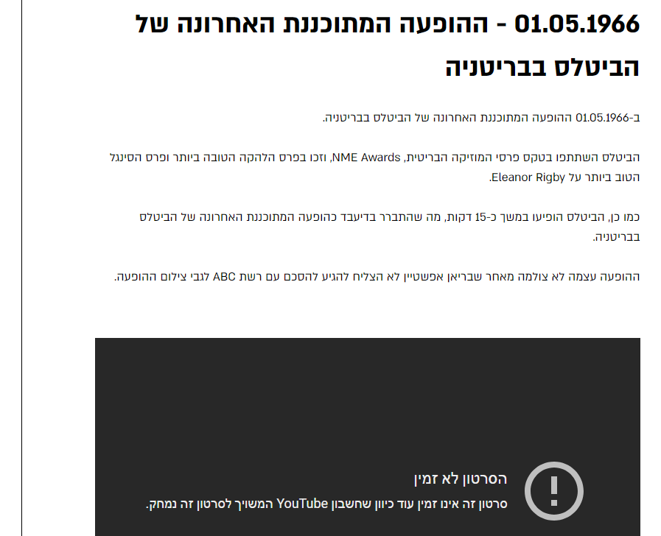

Slide 18
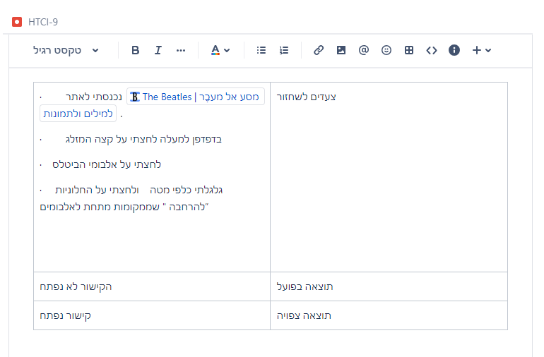
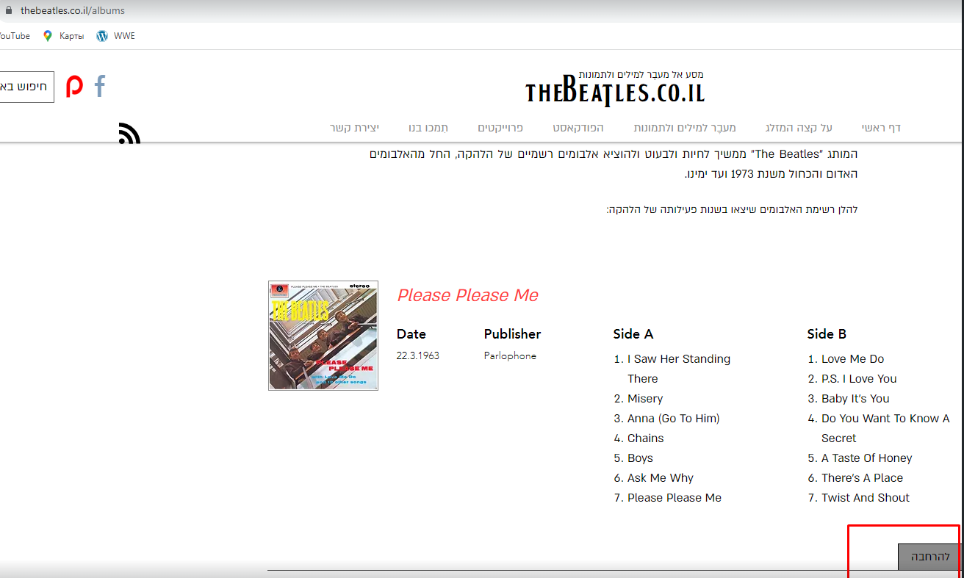

Slide 19
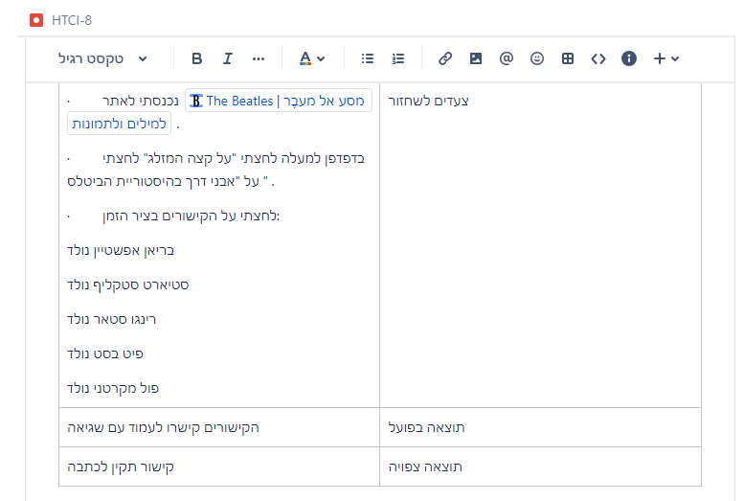
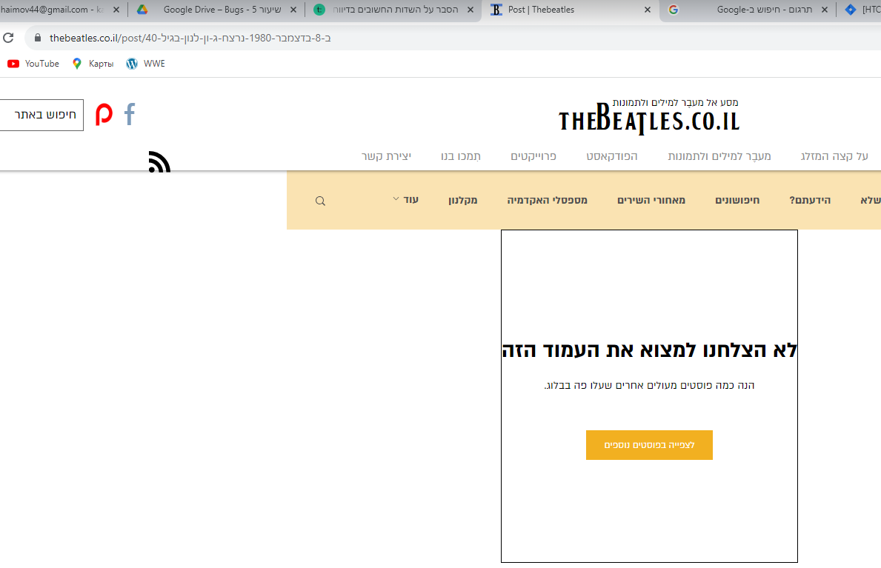

Slide 20
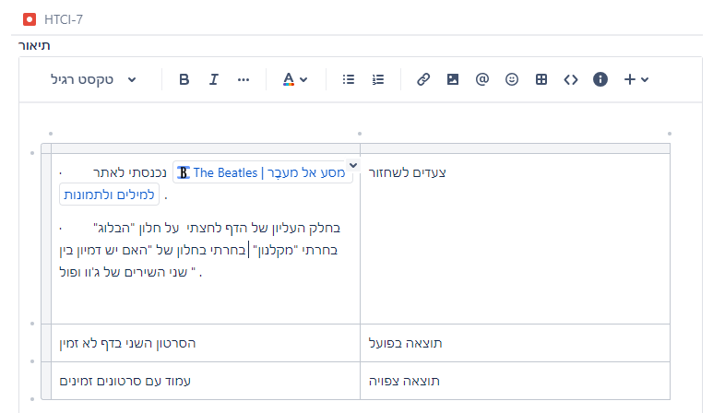
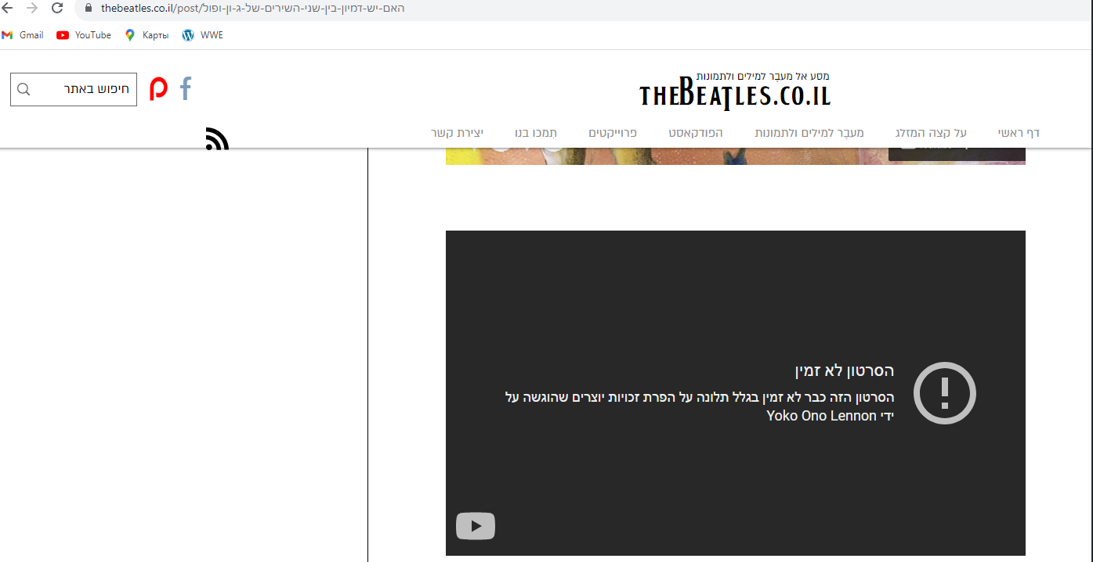

Slide 21
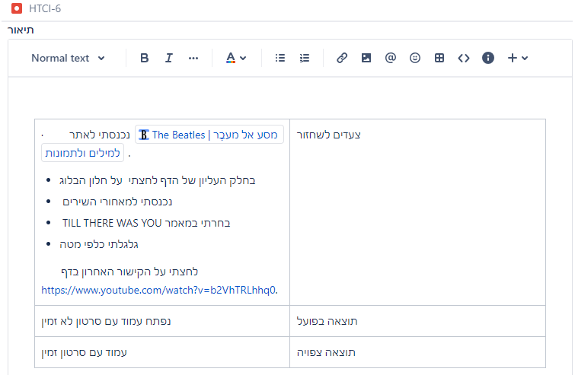
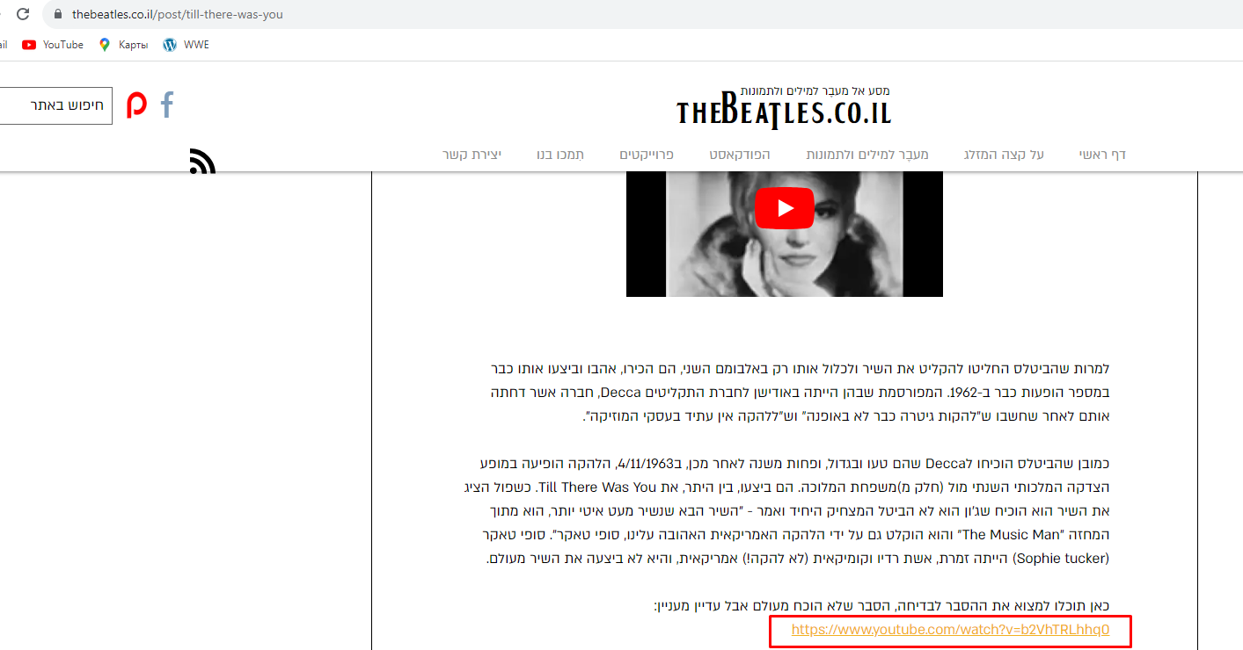

Slide 22
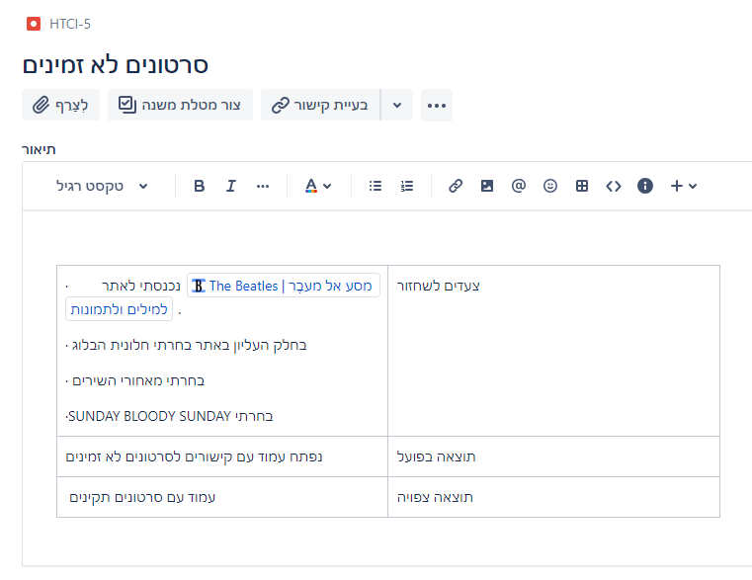
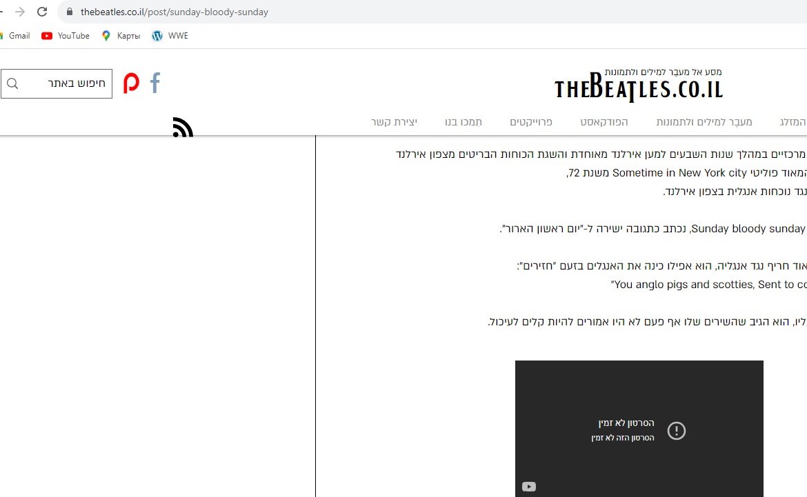

Slide 23
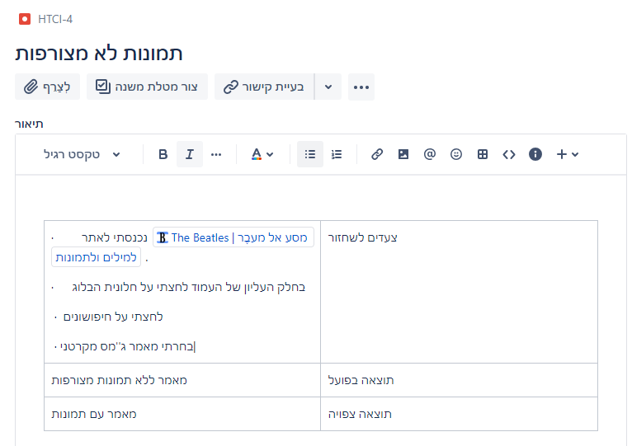
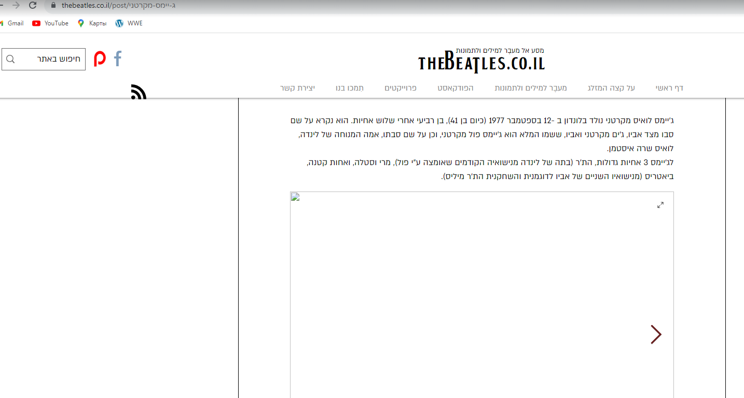

Slide 24
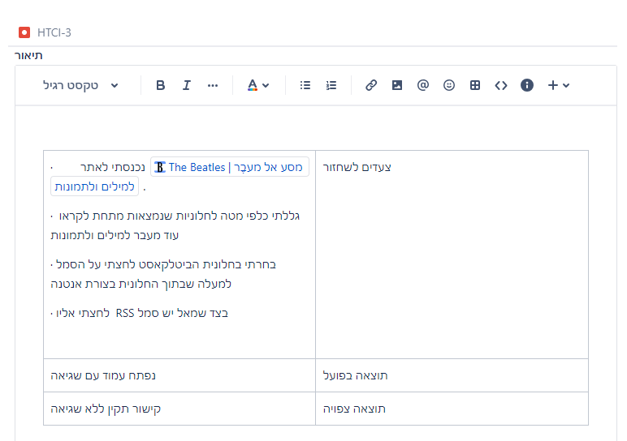
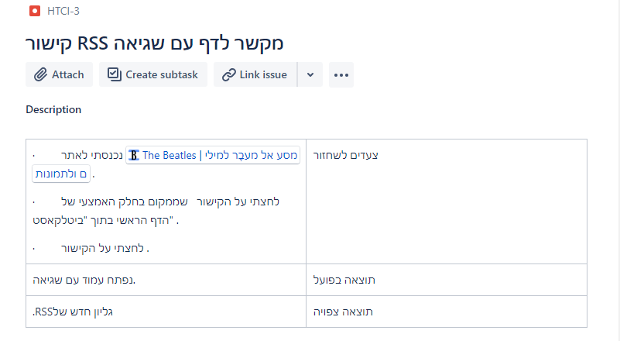
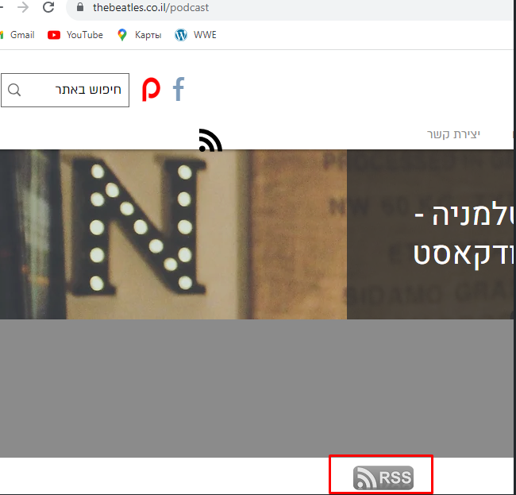

Slide 25
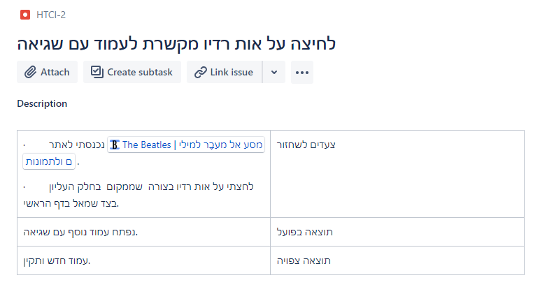
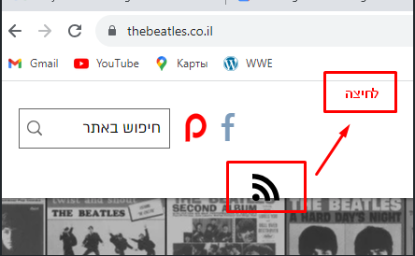

Slide 26
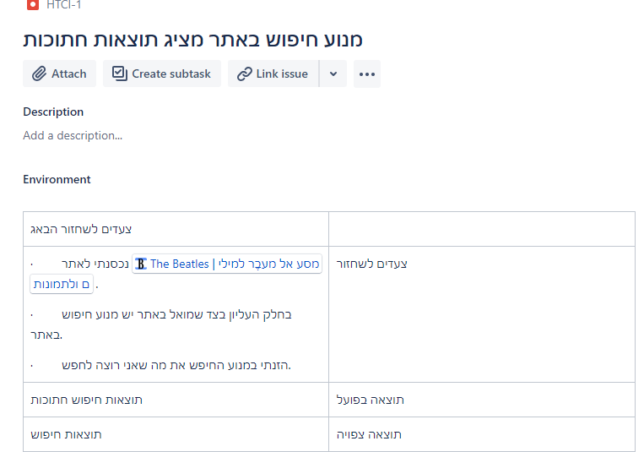
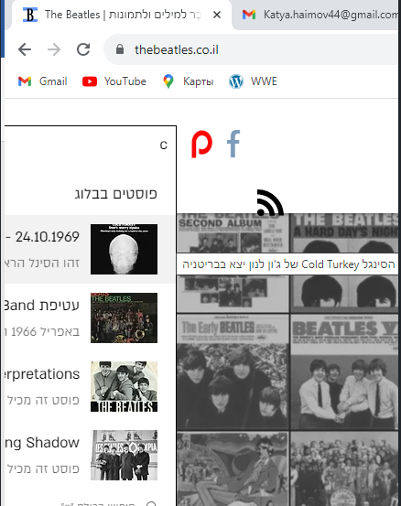

Slide 27
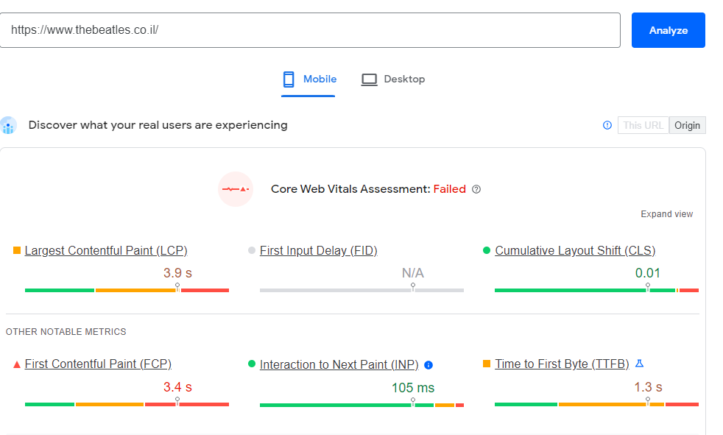
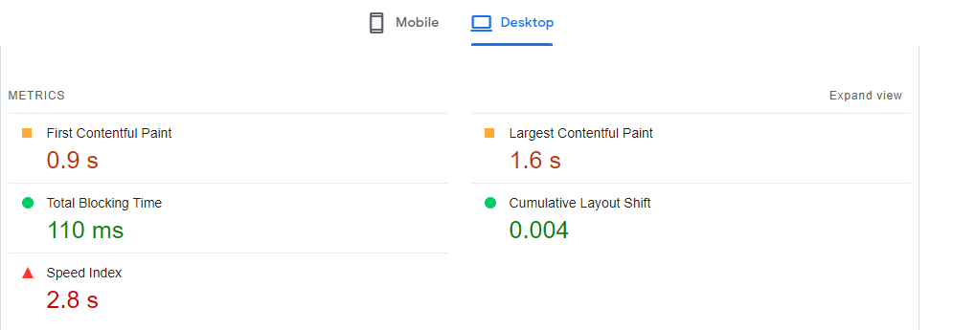

Slide 28
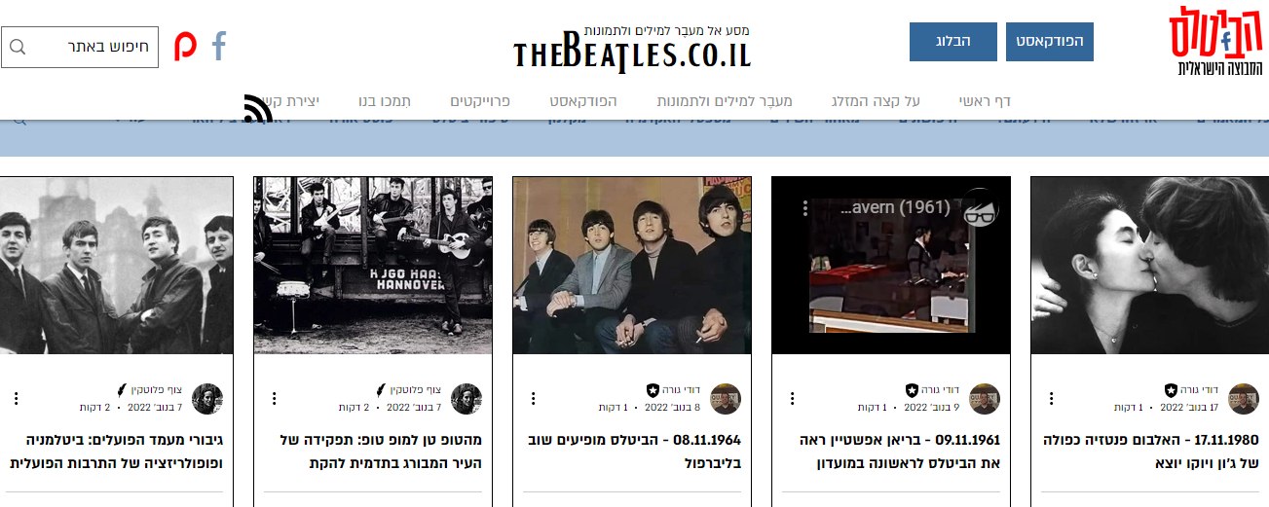
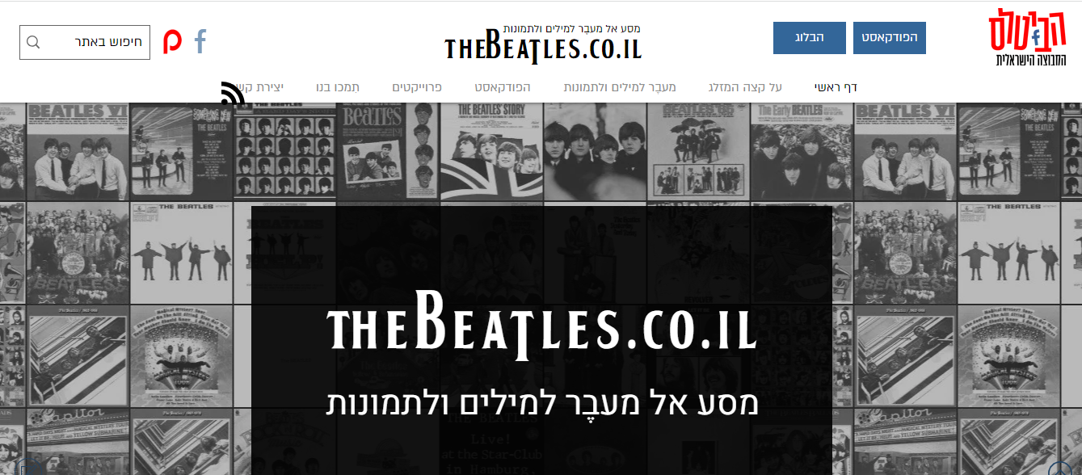
Sample Test Summary Report Created and published by:
https://www.thebeatles.co.il/history

